Slide 1






Jak bezpečně kombinovat AT léčbu nem. s FS a PCI?
O. Hlinomaz
IKAK, ICRC, FN u sv. Anny, Brno CINRE, Bratislava
Tato přednáška je podpořena spol. Pfizer.

Slide 2
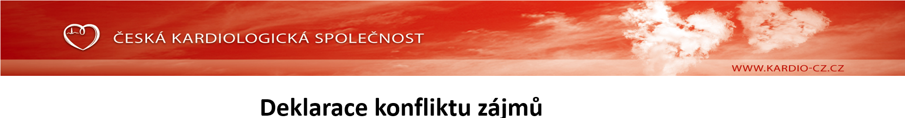
 | Nemám konflikt zájmů | Mám konflikt zájmů | Specifikace konfliktu (vyjmenujte subjekty, firmy či instituce, se kterými Vaše spolupráce může vést ke konfliktu zájmů)
Zaměstnanecký poměr | X
Vlastník / akcionář | X
Konzultant | X
Přednášková činnost |  | X | Pfizer, Boehringer
Člen poradních sborů (advisory boards) | X
Podpora výzkumu / granty | X
Jiné honoráře (např. za klinické studie či registry) | X

Slide 3

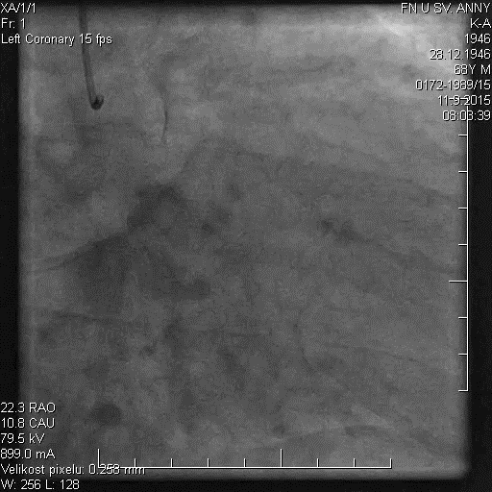
Riziko ischemických příhod
M, 69 let
NSTEMI
Preterminal neg. II,III,aVF,V4-6
DM II 5 let
Hypertenze
Obezita
Kolorektální Ca 2014- CH,R

Slide 4
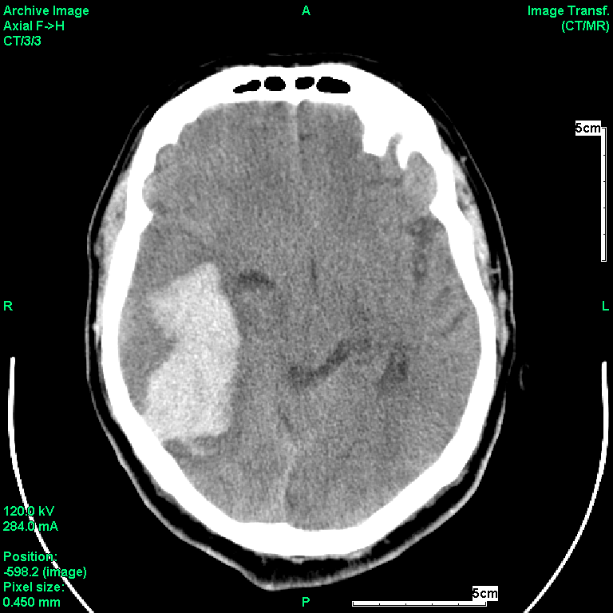
Mozkové krvácení

Slide 5

Perfektní práce intervenčního kardiologa
KVALITA NA 1. MÍSTĚ
Příprava léze
DES 1:1, nová generace, výsl. studií
Vysotlaká postdilatace
OCT, IVUS
DES – drug-eluting stent, IVUS - Intravascular ultrasound, OCT - optical coherence tomography

Slide 6
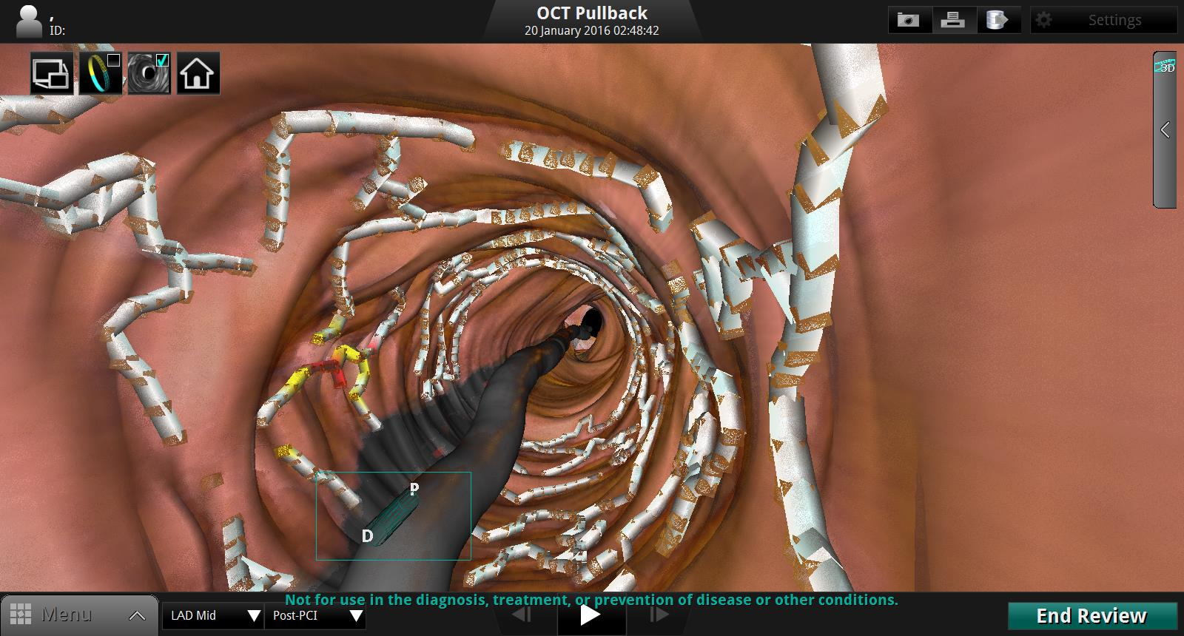
Velmi dobrá apozice stentu

Slide 7
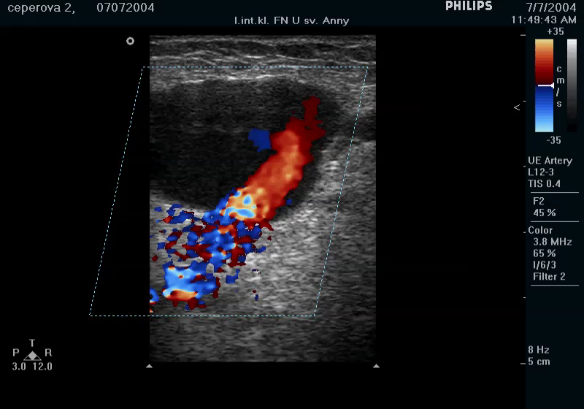
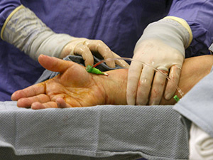
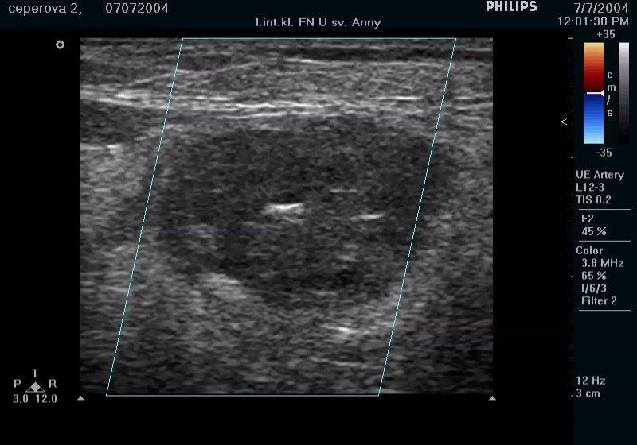
Radiální přístup - lepší než femorální
96% (5-25-47%)
Mates et. al, Cor Vasa 2019;61:e123–e156.

Slide 8
RE-DUAL PCI
Dabigatran 150 mg 2x denně + P2Y12 inhibitor
Pacienti s FS podstupující PCI se stentem
Primární cíl:
závažné a klinicky významné nezávažné krvácení (ISTH)
R
Dabigatran 110 mg 2x denně + P2Y12 inhibitor
N=2725
Randomizace
≤120 hodin
po PCI*
Warfarin (INR 2,0–3,0) + P2Y12 inhibitor + ASA
minimální doba léčby 6 měsíců,
maximální doba léčby 30 měsíců
(střední doba sledování ~14 měsíců)
Dabigatran (110 nebo 150 mg)
P2Y12 inhibitor
Warfarin
P2Y12 inhibitor
1 měsíc ASA - kovový stent (BMS)
3 měsíce ASA - lékový stent (DES)
RE-DUAL PCI - multicentrická, prospektivní, randomizovaná, otevřená studie se zaslepenými end-pointy; *Studijní medikace byla podána 6 hodin po vytažení šítu a ne později než 120 hodin po PCI (≤72 hodin preferováno); ASA - kyselina acetylsalicylová; R - randomizace;
Cannon et al. Clin Cardiol 2016; Cannon et al. N Engl J Med 2017
Notes:
References
Cannon CP et al. Clin Cardiol 2016;39:555–64
Cannon CP et al. N Engl J Med 2017;doi: 10.1056/NEJMoa1708454
P2Y12 inhibitor
Clopidogrel 75 mg once daily or ticagrelor 90 mg twice daily according to the local label for ≥12 months following randomization, with the choice of agent at the discretion of the investigator. Discontinuation of clopidogrel or ticagrelor or switching to ASA (≤100 mg once daily) after 12 months of treatment will also be at the discretion of the investigator. The use of prasugrel was not allowed.
Treatment duration
6-month minimum treatment duration with visits every 3 months for the first year, then visits and telephone contact alternating every 3 months and a 1-month post-treatment visit.
Patients had a 4-week follow-up visit, and telephone follow-ups were conducted at 15, 21, and 27 months.
Formally tested endpoint included:
- Non-inferiority and superiority of 110 mg and 150 mg dual therapy in time to first ISTH major bleeding event or clinically relevant non-major bleeding event
- Time to first event of death, thromboembolic event (MI, stroke, systemic embolism) with and without unplanned revascularization

Slide 9
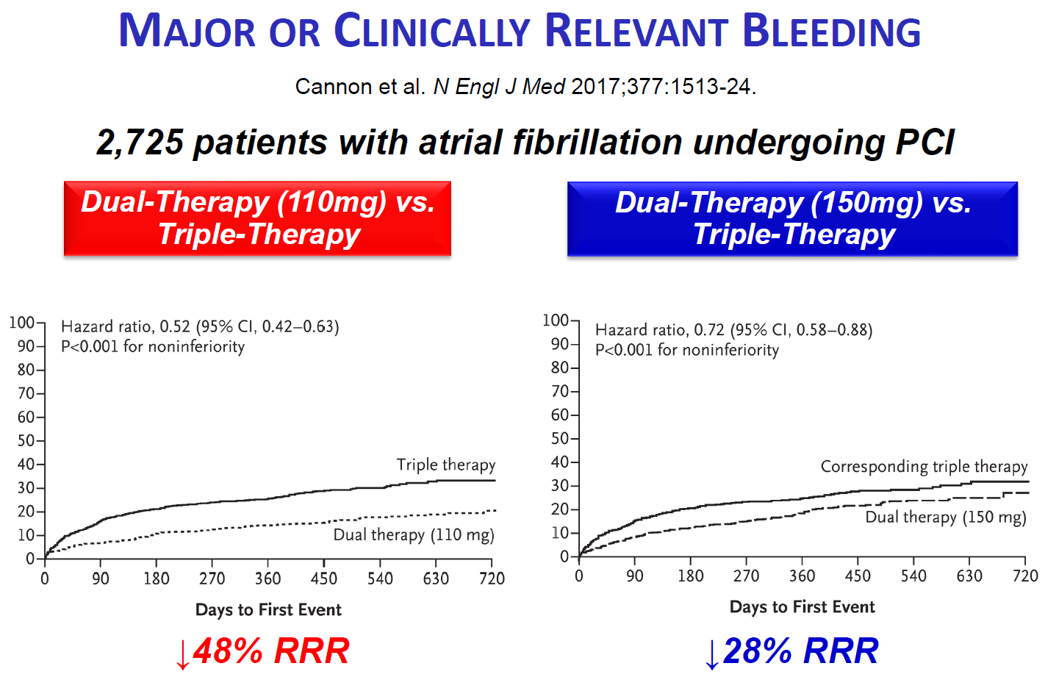
RE-DUAL PCI
Cannon et al. Clin Cardiol 2016; Cannon et al. N Engl J Med 2017
Notes:
Anti-thrombotic management of patients with nonvalvular AF undergoing PCI represents a clinical challenge, as therapeutic anticoagulation is known to prevent ischemic stroke while dual anti-platelet therapy (DAPT) with aspirin and a thienopyridine (e.g., clopidogrel, ticagrelor) is generally considered standard of care to prevent stent thrombosis in the post-PCI period. At the same time, so called "triple therapy" with aspirin, a thienopyridine, and an oral anticoagulant has been shown to result in high rates of clinical bleeding.
In an effort to refine the balance of antithrombotic protection and risk of bleeding, there has been significant interest in assessing the safety and efficacy of several intermediate anti-thrombotic regimens in this population.The 2013 WOEST trial demonstrated that dual therapy with warfarin and clopidogrel post-PCI resulted in a 25% absolute reduction in bleeding events when compared to triple therapy. Thrombosis rates were similar in both groups, although the trial was not adequately powered for thrombosis events. The ISAR-TRIPLE trial demonstrated that a shorter duration of triple therapy (6 weeks as opposed to 6 months) was also associated with a lower rate of bleeding with similar rates of thrombosis. More recently, the PIONEER-AF-PCI trial randomized patients with AF to triple therapy using warfarin, triple therapy using a very low dose of the direct-acting oral anticoagulant (DOAC) rivaroxaban, and dual therapy using a thienopyridine and full-dose rivaroxaban. PIONEER-AF-PCI demonstrated that both triple therapy using very low dose rivaroxaban and dual therapy using full-dose rivaroxaban were both associated with significantly less major bleeding then triple therapy using warfarin, with similar thrombosis rates among all three groups. Largely based on the the results of WOEST, current ACC/AHA guidelines provide a class IIb recommendation ("reasonable") for dual therapy using clopidogrel and oral anticoagulation without aspirin in patients with AF and elevated stroke risk following PCI.
The 2017 Randomized Evaluation of Dual Antithrombotic Therapy with Dabigatran versus Triple Therapy with Warfarin in Patients with Nonvalvular Atrial Fibrillation Undergoing Percutaneous Coronary Intervention (RE-DUAL PCI) trial randomized 2725 patients with AF undergoing PCI (for acute coronary syndrome in 51% of cases) to a) triple therapy using aspirin, thienopyridine (plavix or ticagrelor), and warfarin (goal INR 2-3), b) dual therapy using thienopyridine and dabigatran 150MG twice daily, and c) dual therapy using thienopyridine and dabigatran 110MG twice daily, and assessed for a primary outcome of major or clinically relevant nonmajor bleeding. Due to labeling recommendations for dose adjustment only present outside the US, elderly patients outside the US were randomized only to triple therapy including warfarin or dual therapy using dabigatran 110MG twice daily. Patients receiving triple therapy were given aspirin for 1-3 months post-PCI and all patients received a thienopyridine for 12 months post-PCI. At mean follow-up 14 months, triple therapy was associated with an 11.5% absolute increase in the primary outcome over the dabigatran 110MG twice daily dual therapy group and a 5.5% absolute increase over the dabigatran 150MG twice daily dual therapy group (which did not include elderly patients outside the US). In secondary efficacy analyses assessing for thrombotic events, rates of myocardial infarction, stroke, systemic embolism, death, or unplanned revascularization were similar across the three groups, although a pooled analysis combining both doses of dabigatran dual therapy demonstrated a modest and non-significant 1.1% absolute increase in thrombotic events or death compared to the triple therapy group.
In summary, RE-DUAL PCI adds to accumulating evidence suggesting that "triple therapy" with aspirin, a thienopyridine antiplatelet agent, and full-dose oral anticoagulation is associated with higher rates of bleeding without clear evidence of improved thrombotic protection (either stroke or MI/stent thrombosis) in patients with AF after PCI. Similar to previous studies, RE-DUAL PCI was underpowered to robustly assess for thrombotic outcomes and a pooled analysis involving both dual therapy groups did suggest a small signal towards possible increased thrombosis rates. Notably, however, the rate of thromboembolic events or death was actually lower in the 150MG dabigatran dual therapy group when compared to the corresponding triple therapy group, suggesting that the signal towards more thrombosis may be driven solely by dual therapy using 110MG dabigatran. On balance, these findings suggest that dual therapy with a thienopyridine antiplatelet agent and oral anticoagulation without aspirin appears to be a reasonable compromise between providing adequate thrombotic protection and minimizing bleeding risk in appropriately selected patients. Importantly, triple therapy using aspirin, a thienopyridine, and very low dose DOAC is also another candidate approach that was not assessed in RE-DUAL PCI. Further study is necessary to define the optimal OAC dosing strategy and duration of antiplatelet therapy in this population.
Guidelines

Slide 10
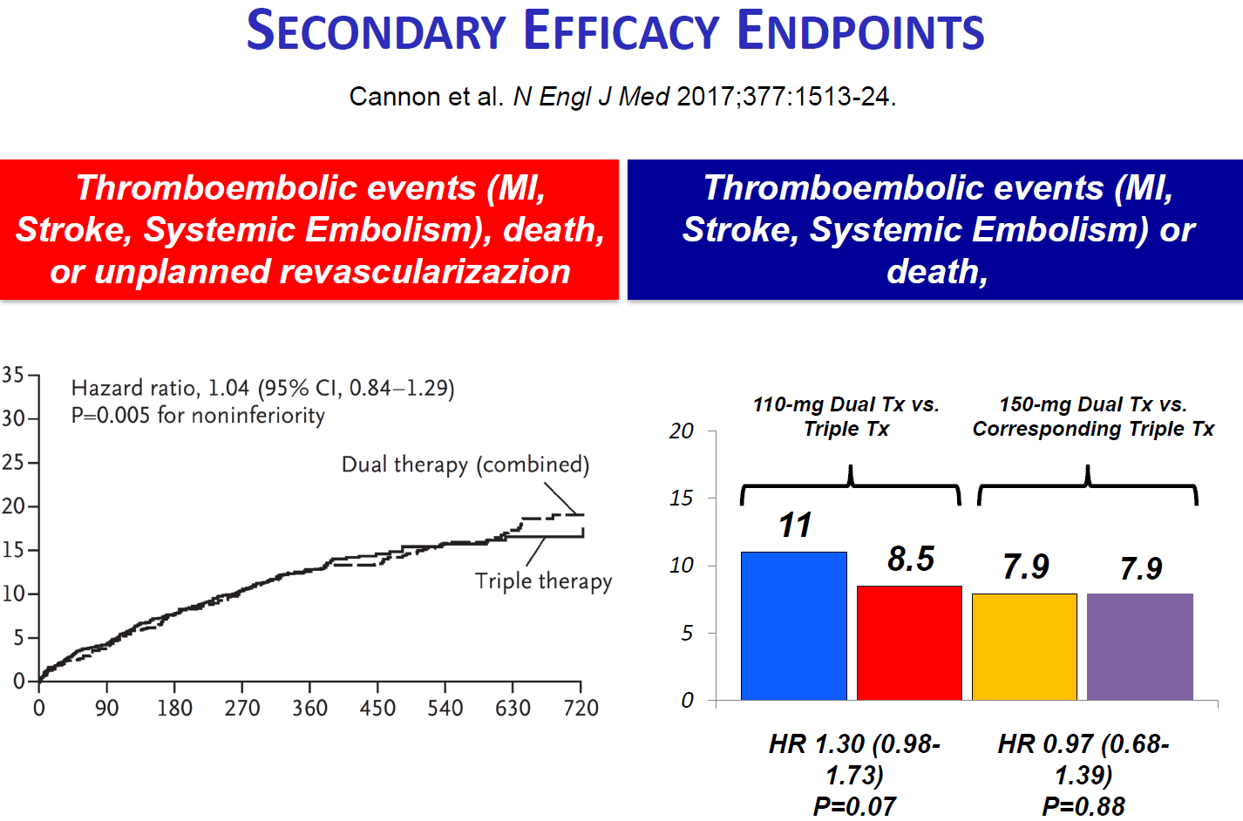
RE-DUAL PCI
Cannon et al. Clin Cardiol 2016; Cannon et al. N Engl J Med 2017
Notes:
Anti-thrombotic management of patients with nonvalvular AF undergoing PCI represents a clinical challenge, as therapeutic anticoagulation is known to prevent ischemic stroke while dual anti-platelet therapy (DAPT) with aspirin and a thienopyridine (e.g., clopidogrel, ticagrelor) is generally considered standard of care to prevent stent thrombosis in the post-PCI period. At the same time, so called "triple therapy" with aspirin, a thienopyridine, and an oral anticoagulant has been shown to result in high rates of clinical bleeding.
In an effort to refine the balance of antithrombotic protection and risk of bleeding, there has been significant interest in assessing the safety and efficacy of several intermediate anti-thrombotic regimens in this population.The 2013 WOEST trial demonstrated that dual therapy with warfarin and clopidogrel post-PCI resulted in a 25% absolute reduction in bleeding events when compared to triple therapy. Thrombosis rates were similar in both groups, although the trial was not adequately powered for thrombosis events. The ISAR-TRIPLE trial demonstrated that a shorter duration of triple therapy (6 weeks as opposed to 6 months) was also associated with a lower rate of bleeding with similar rates of thrombosis. More recently, the PIONEER-AF-PCI trial randomized patients with AF to triple therapy using warfarin, triple therapy using a very low dose of the direct-acting oral anticoagulant (DOAC) rivaroxaban, and dual therapy using a thienopyridine and full-dose rivaroxaban. PIONEER-AF-PCI demonstrated that both triple therapy using very low dose rivaroxaban and dual therapy using full-dose rivaroxaban were both associated with significantly less major bleeding then triple therapy using warfarin, with similar thrombosis rates among all three groups. Largely based on the the results of WOEST, current ACC/AHA guidelines provide a class IIb recommendation ("reasonable") for dual therapy using clopidogrel and oral anticoagulation without aspirin in patients with AF and elevated stroke risk following PCI.
The 2017 Randomized Evaluation of Dual Antithrombotic Therapy with Dabigatran versus Triple Therapy with Warfarin in Patients with Nonvalvular Atrial Fibrillation Undergoing Percutaneous Coronary Intervention (RE-DUAL PCI) trial randomized 2725 patients with AF undergoing PCI (for acute coronary syndrome in 51% of cases) to a) triple therapy using aspirin, thienopyridine (plavix or ticagrelor), and warfarin (goal INR 2-3), b) dual therapy using thienopyridine and dabigatran 150MG twice daily, and c) dual therapy using thienopyridine and dabigatran 110MG twice daily, and assessed for a primary outcome of major or clinically relevant nonmajor bleeding. Due to labeling recommendations for dose adjustment only present outside the US, elderly patients outside the US were randomized only to triple therapy including warfarin or dual therapy using dabigatran 110MG twice daily. Patients receiving triple therapy were given aspirin for 1-3 months post-PCI and all patients received a thienopyridine for 12 months post-PCI. At mean follow-up 14 months, triple therapy was associated with an 11.5% absolute increase in the primary outcome over the dabigatran 110MG twice daily dual therapy group and a 5.5% absolute increase over the dabigatran 150MG twice daily dual therapy group (which did not include elderly patients outside the US). In secondary efficacy analyses assessing for thrombotic events, rates of myocardial infarction, stroke, systemic embolism, death, or unplanned revascularization were similar across the three groups, although a pooled analysis combining both doses of dabigatran dual therapy demonstrated a modest and non-significant 1.1% absolute increase in thrombotic events or death compared to the triple therapy group.
In summary, RE-DUAL PCI adds to accumulating evidence suggesting that "triple therapy" with aspirin, a thienopyridine antiplatelet agent, and full-dose oral anticoagulation is associated with higher rates of bleeding without clear evidence of improved thrombotic protection (either stroke or MI/stent thrombosis) in patients with AF after PCI. Similar to previous studies, RE-DUAL PCI was underpowered to robustly assess for thrombotic outcomes and a pooled analysis involving both dual therapy groups did suggest a small signal towards possible increased thrombosis rates. Notably, however, the rate of thromboembolic events or death was actually lower in the 150MG dabigatran dual therapy group when compared to the corresponding triple therapy group, suggesting that the signal towards more thrombosis may be driven solely by dual therapy using 110MG dabigatran. On balance, these findings suggest that dual therapy with a thienopyridine antiplatelet agent and oral anticoagulation without aspirin appears to be a reasonable compromise between providing adequate thrombotic protection and minimizing bleeding risk in appropriately selected patients. Importantly, triple therapy using aspirin, a thienopyridine, and very low dose DOAC is also another candidate approach that was not assessed in RE-DUAL PCI. Further study is necessary to define the optimal OAC dosing strategy and duration of antiplatelet therapy in this population.
Guidelines

Slide 11
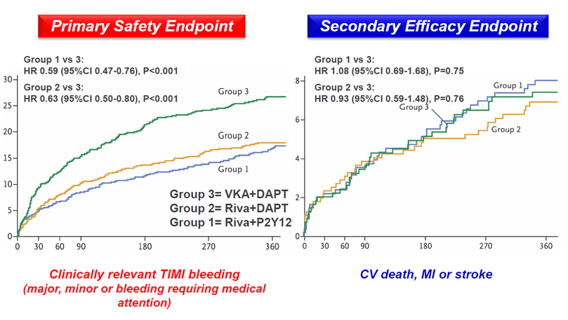
PIONEER AF-PCI
Gibson MC et al.: NEJM 2016;375:2423-34
Notes:
Up to 1 in 10 patients undergoing PCI have AF. Prior to the publication of WOEST (2013) and ISAR-TRIPLE (2015), clinical practice guidelines suggested that this particular patient population should be placed on a triple therapy anticoagulation strategy post-PCI with warfarin and dual antiplatelet therapy (DAPT). However, since WOEST and ISAR-TRIPLE, current AHA/ACC guidelines suggest that in patients with nonvalvular AF undergoing PCI, it is reasonable to maintain patients on oral anticoagulation (typically warfarin) and clopidogrel without ASA.
Based on data from RE-LY (2009), ARISTOTLE (2011), and ROCKET AF (2011), there is accumulating evidence supporting the use of direct oral anticoagulants (DOACs) in patients with AF compared to warfarin. However, prior to the publication of PIONEER AF-PCI, there were no clinical trials to support the use of DOACs in patients with nonvalvular AF undergoing PCI with stent placement.Published in 2016, the PIONEER AF-PCI trial randomized 2,214 patients with nonvalvular AF who had just undergone PCI with stent placement to one of three treatment groups:
Rivaroxaban 10-15 mg daily+P2Y₁₂ inhibitor x12 mo
Rivaroxaban 2.5 mg BID+DAPT x1, 6, or 12 mo
Warfarin+DAPT x1, 6, or 12 mo
Prakticky vždy clopidogrel
10mg rivarox u všech s clerance pod 50
Vyřazeni pac. s krvácením do GIT a po CMP
At 12 months, the primary outcome of clinically significant bleeding was lower in the rivaroxaban groups than the warfarin groups (16.8% vs. 18.0% vs. 26.7%). There was no significant difference in the rate of major adverse cardiovascular events (CV mortality, MI, or stroke) between the three groups but the trial. However, this trial was not powered to detect a difference between the groups.
It should be noted that both of the dosing regimens of rivaroxaban (15 mg daily or 2.5 mg twice daily) used in the trial have not been formally investigated and are not FDA approved for AF or acute coronary syndromes. And, while lower than approved doses of rivaroxaban were used in this trial, a lower INR target was not tested.

Slide 12
Antitrombotická terapie po akutním koronárním syndromu (AKS) nebo perkutánní koronární intervenci (PCI) u pacientů s FS
(AUGUSTUS)
Lopes RD¹; Heizer G¹; Aronson R²; Vora AN¹; Massaro T¹; Mehran R³; Goodman SG⁴; Windecker S⁵; Darius H⁶; Li J²; Averkov O⁸; Bahit MC⁹; Berwanger O¹⁰; Budaj A¹¹; Hijazi Z¹²; Parkhomenko A¹³; Sinnaeve P¹⁴; Storey RF¹⁵; Thiele H⁷; Vinereanu D¹⁶; Granger CB¹; Alexander JH¹ on behalf of the AUGUSTUS Investigators.
AUGUSTUS was funded by Bristol-Myers Squibb and Pfizer
Lopes RD et al. N Engl J Med. March 17, 2019;

Slide 13
AUGUSTUS
NVAF (předchozí, persistentní/permanentní, paroxysmální)
    Rozhodnutí lékaře o nutnosti podávání antikoagulace.
    AKS a/nebo PCI s plánovým podáváním P2Y₁₂ inhibitoru pod dobu alespoň 6 měsíců.
    Vyřazeni:
    Kontraindikace k duální protidestičkové léčbě.
    Jiný důvod pro podávání VKA (mechanická srdeční chlopeň, stř. závažná/závažná mitrální stenóza).
Srovnání antikoagulace
(n = 4614)²
Srovnání antiagregace
(n = 4614)²
2 x 2 faktorový design
1:1:1:1 randomizace
do 4 léčebných režimů
Open Label
Dvojitě zaslepené
apixaban 5 mg BID
2.5 mg BID if criteria met*
VKA
(INR 2.0 to 3.0)
ASA 81 mg QD
placebo
Double
Blind
Double
Blind
Open
Label
Open
Label
ASA
Placebo
ASA
Placebo
Apixaban
VKA
Apixaban
VKA
P2Y₁₂ inhibitor pro všechny pacienty 6 měsíců.
P2Y₁₂ inhibitor pro všechny pacienty 6 měsíců.
*dávka byla redukovaná na 2.5 mg BID v případě, že pacient splňoval min. 2 z těchto kritérií: věk ≥ 80 let, váha ≤ 60 kg, nebo creatinin v séru ≥ 1.5 mg/dL (133 µmol/L).
Lopes RD et al. N Engl J Med. March 17, 2019;
Notes:
BMS/Pfizer has obtained copyright permission from the American Heart Journal to use the figure for reactive medical information use only. CCC database checked for digital responsive rights on 31.3.19.

Slide 14
AUGUSTUS
Základní charakteristiky
 | Apixaban N=2,306 | VKA N=2,308 | Aspirin N=2,307 | Aspirin Placebo N=2,307 | Total N=4,614
Median age, years | 70.4 | 70.9 | 70.8 | 70.6 | 70.7
Female, % | 29.1 | 28.9 | 30.2 | 27.8 | 29.0
CHA₂DS₂-VASc score, mean | 3.9±1.6 | 4.0±1.6 | 3.9±1.6 | 3.9±1.6 | 3.9±1.6
HAS-BLED score, mean | 2.9±1.0 | 2.9±0.9 | 2.8±0.9 | 2.9±1.0 | 2.9±0.9
Qualifying index event ACS and PCI Medically managed ACS Elective PCI | 873 (38.0%) 547 (23.8%) 877 (38.2%) | 841 (36.6%) 550 (23.9%) 907 (39.5%) | 844 (36.8%) 547 (23.9%) 902 (39.3%) | 870 (37.8%) 550 (23.9%) 882 (38.3%) | 1,714 (37.3%) 1,097 (23.9%) 1,784 (38.8%)
Days from index event,* mean (SD) | 6.7 (4.2) | 6.6 (4.2) | 6.7 (4.3) | 6.5 (4.1) | 6.6 (4.2)
Prior OAC,† no. (%) | 1,192 (51.7%) | 1,070 (46.4%) | 1,132 (49.1%) | 1,130 (49.0%) | 2,262 (49.0%)
P2Y₁₂ inhibitor concomitant medication at randomisation, no (%) Clopidogrel Ticagrelor Prasugrel | 2,105 (93.4%) 121 (5.4%) 27 (1.2%) | 2,060 (91.8%) 159 (7.1%) 24 (1.1%) | 2,075 (92.1%) 147 (6.5%) 31 (1.4%) | 2,090 (93.2%) 133 (5.9%) 20 (0.9%) | 4,165 (92.6%) 280 (6.2%) 51 (1.1%)
*If patient has both ACS and PCI, the date of ACS is used; †Number of subjects who discontinued use of any OAC on or before randomisation.
Lopes RD, et al. N Engl J Med 2019;380:1509–1524

Slide 15
Primární cíl velké nebo klinicky významné krvácení
Apixaban vs VKA
Aspirin vs aspirin placebo
20
HR: 0.69, 95% CI: 0.58–0.81
P<0.001 for non-inferiority
P<0.001 for superiority
ARR=4.2%
NNT=24
20
HR: 1.89, 95% CI: 1.59–2.24
P<0.001
ARI=7.1%
NNH=14
VKA: 14.7%
Aspirin: 16.1%
15
15
Cumulative incidence
of event (%)
Cumulative incidence
of event (%)
Placebo: 9.0%
10
10
Apixaban: 10.5%
5
5
0
0
0
30
60
90
120
150
180
0
30
60
90
120
150
180
Number at risk:
Apixaban
VKA
Days since start of intervention
Number at risk:
Aspirin
Placebo
Days since start of intervention
2,290
2,259
2,110
1,984
2,019
1,861
1,957
1,795
1,902
1,736
1,858
1,686
1,037
1,079
2,277
2,279
2,003
2,095
1,863
2,006
1,789
1,941
1,717
1,880
1,674
1,824
962
1,079
P2Y₁₂ inhibitor pro všechny pacienty po dobu 6 měsíců.
    závažné (ISTH) nebo klinicky relevantní nezávažné (CRNM) krvácení
ARI: absolute risk increase; ARR: absolute risk reduction; CI: confidence interval; HR: hazard ratio; NNH: number needed to harm; NNT: number needed to treat.
Lopes RD, et al. N Engl J Med 2019;380:1509–1524

Slide 16
Primární cíl velké nebo klinicky významné krvácení
20
VKA + aspirin: 18.7%
15
Apixaban + aspirin: 13.8%
Cumulative incidence
of event (%)
VKA + placebo: 10.9%
10
Apixaban + placebo: 7.3%
5
0
0
30
60
90
120
150
180
Apixaban + placebo
vs VKA + aspirin:
11.4% absolute risk
reduction (NNT=9)
Days since start of intervention
Number at risk:
Apixaban and aspirin
Apixaban and placebo
VKA and aspirin
VKA and placebo
1,145
1,143
1,123
1,126
1,036
1,075
962
1,007
975
1,044
881
947
937
1,007
838
917
903
975
800
883
880
947
776
851
485
536
467
528
Studie AUGUSTUS neměla statistickou sílu k porovnání jednotlivých podskupin
Lopes RD, et al. N Engl J Med 2019;380:1509–1524 [Suppl appendix]

Slide 17
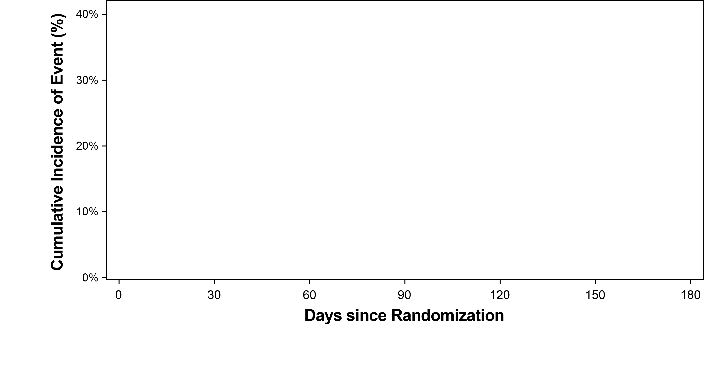
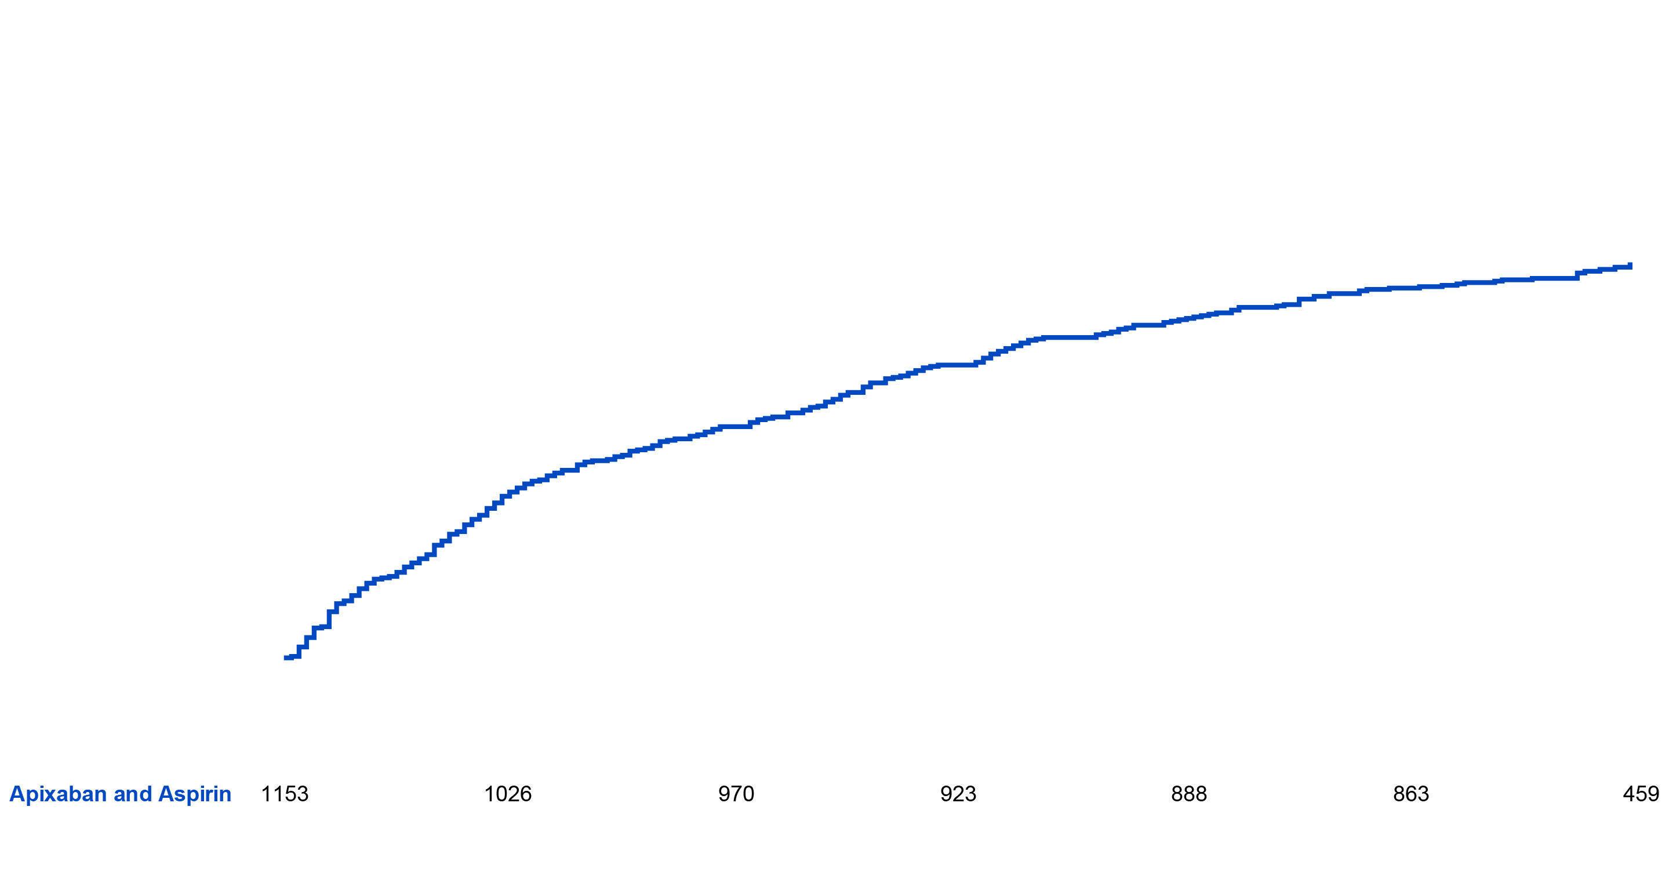
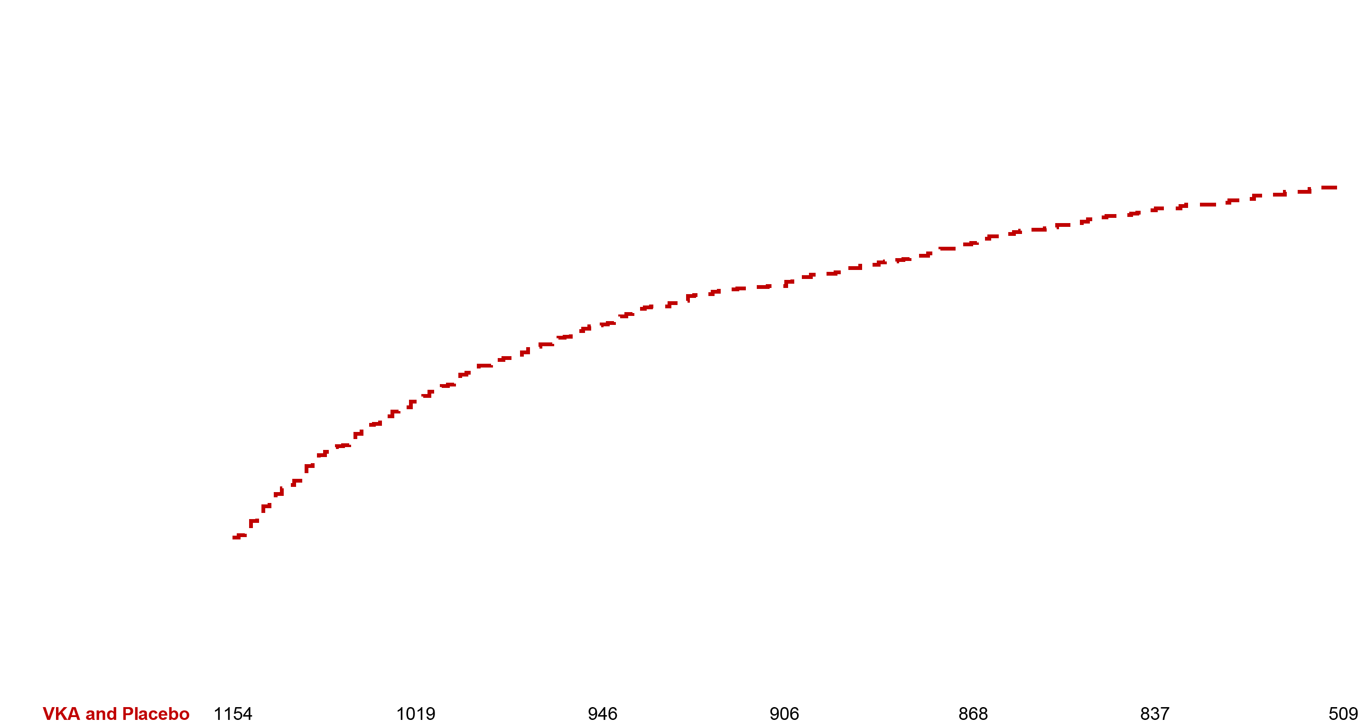
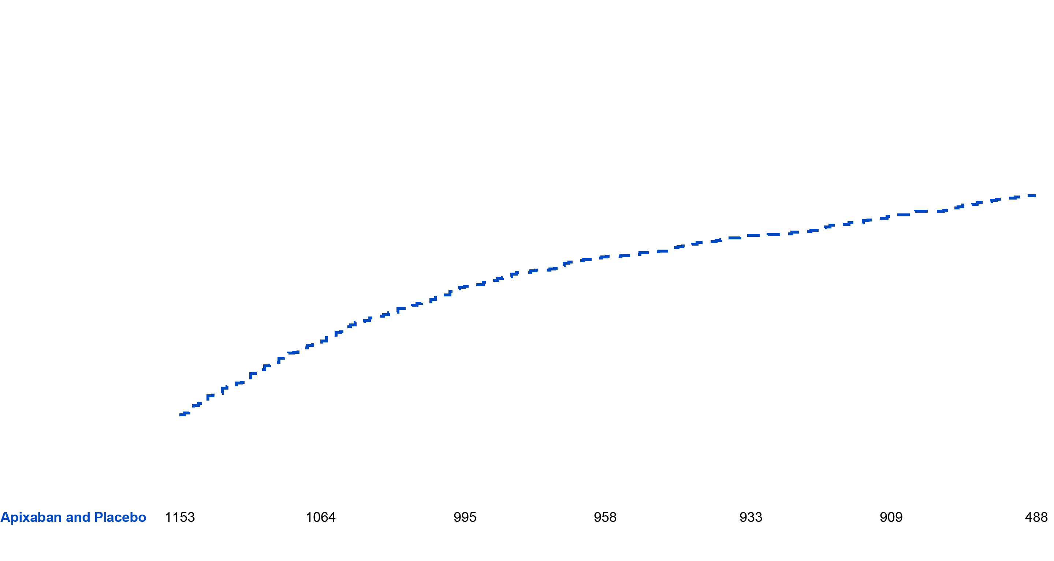
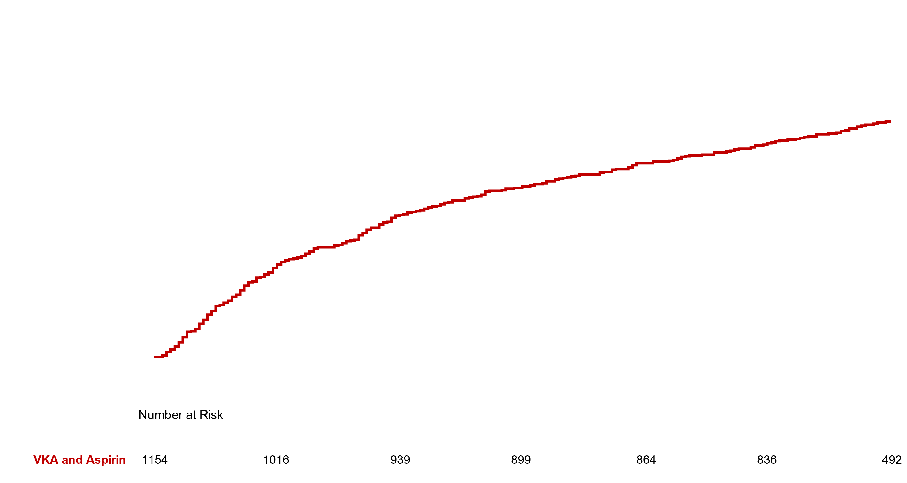
Sekundární cíl úmrtí/ hospitalizace
VKA + Aspirin (27.5%)
VKA + Placebo (27.3%)
Apixaban + Aspirin (24.9%)
Apixaban + Placebo (22.0%)
Apixaban + Placebo
vs. VKA + Aspirin:
5.5% absolute risk
reduction (NNT=18)
Lopes RD, et al. N Engl J Med 2019;380:1509–1524

Slide 18
Sekundární cíl úmrtí nebo ischemické příhody apixaban vs. VKA
Koncový parametr | apixaban (%/rok) (n = 2306) | VKA (%/rok) (n = 2308) | Poměr rizik (95% CI)
Úmrtí/ischemická příhoda (%) | 14.3 | 15.3 | 0.93 (0.75 to 1.16)
Úmrtí (%) | 7.0 | 6.7 | 1.03 (0.75 to 1.42)
Úmrtí z KV příčin (%) | 5.2 | 4.9 | 1.05 (0.72 to 1.52)
CMP (%) | 1.2 | 2.4 | 0.50 (0.26 to 0.97)
IM (%) | 6.6 | 7.4 | 0.89 (0.65 to 1.23)
Potvrzená či pravděpodobná trombóza stentu dle ARC (%) | 1.3 | 1.6 | 0.77 (0.38 to 1.56)
Urgentní revaskularizace (%) | 3.7 | 4.1 | 0.90 (0.59 to 1.38)
Hospitalizace (%) | 54.8 | 66.5 | 0.83 (0.74 to 0.93)
Všichni pacienti ve studii užívali P2Y₁₂ inhibitor
    Úmrtí nebo ischemické příhody
    (CMP, MI, trombóza stentu, urgentní revaskularizace)
Lopes RD, et al. N Engl J Med 2019;380:1509–1524
Notes:
BMS/Pfizer has obtained copyright permission from the New England Journal of Medical to use this tablefor reactive medical information use only. CCC database checked for digital responsive rights on 1.4.19.

Slide 19
Sekundární cíl úmrtí nebo ischemické příhody ASA vs. placebo
Koncový parametr | aspirin (%/rok) (n = 2307) | placebo (%/rok) (n = 2307) | Poměr rizik (95% CI)
Úmrtí/ischemická příhoda (%) | 13.9 | 15.7 | 0.89 (0.71 to 1.11)
Úmrtí (%) | 6.6 | 7.2 | 0.91 (0.66 to 1.26)
Úmrtí z KV příčin (%) | 4.8 | 5.3 | 0.92 (0.63 to 1.33)
CMP (%) | 1.8 | 1.7 | 1.06 (0.56 to 1.98)
IM (%) | 6.3 | 7.8 | 0.81 (0.59 to 1.12)
Potvrzená či pravděpodobná trombóza stentu dle ARC (%) | 1.0 | 1.9 | 0.52 (0.25 to 1.08)
Urgentní revaskularizace (%) | 3.4 | 4.3 | 0.79 (0.51 to 1.21)
Hospitalizace (%) | 63.7 | 57.5 | 1.10 (0.98 to 1.24)
Všichni pacienti ve studii užívali P2Y₁₂ inhibitor
    Úmrtí nebo ischemické příhody
    (CMP, MI, trombóza stentu, urgentní revaskularizace)
Lopes RD, et al. N Engl J Med 2019;380:1509–1524
Notes:
BMS/Pfizer has obtained copyright permission from the New England Journal of Medical to use this tablefor reactive medical information use only. CCC database checked for digital responsive rights on 1.4.19.

Slide 20
Podobné výsledky u léčených konzervativně, PCI nebo elektivní PCI
Subgroup | Apixaban | VKA | HR (95% CI) | P-value for interaction
ISTH major/CRNM bleeding |  |  |  | 0.052
ACS no PCI | 5.3% | 11.5% | 0.44 (0.28, 0.68)
ACS with PCI | 10.7% | 15.0% | 0.68 (0.52, 0.89)
Elective PCI | 13.7% | 16.3% | 0.82 (0.64, 1.04)
Death or hospitalisation |  |  |  | 0.345
ACS no PCI | 17.7% | 24.4% | 0.71 (0.54, 0.92)
ACI with PCI | 26.2% | 28.8% | 0.88 (0.74, 1.06)
Elective PCI | 24.5% | 27.6% | 0.87 (0.72, 1.04)
0.25
0.5
1
2
4
Favours apixaban
Favours VKA
Studie AUGUSTUS neměla statistickou sílu k porovnání účinnosti jednotlivých skupin
Windecker S, et al. Circulation 2019; [Epub ahead of print]

Slide 21
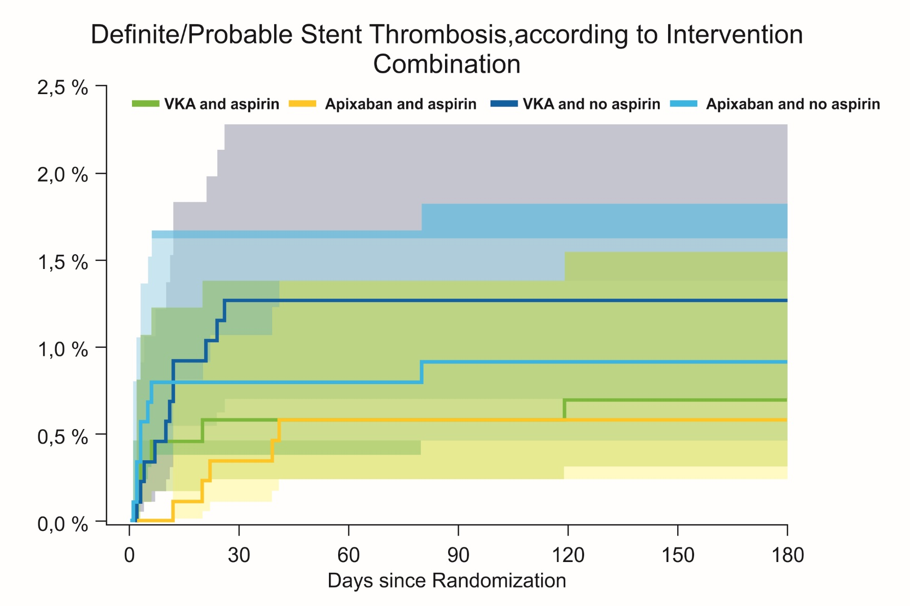
AUGUSTUS trombóza stentu po PCI při fibrilaci síní
1.26%
0.91%
0.69%
0.57%

Slide 22
AUGUSTUS
Zatím největší studie, včetně celého spektra pacientů s ICHS (AKS s / bez PCI, elektivní PCI).
Standardní dávka 5mg 2x denně v triple terapii (apixaban, klopidogrel, ASA) – jediný NOAC studovaný ve standardní dávce v triple terapii.
Ve srovnání s VKA (VKA, P2Y₁₂ inhibitor, ASA/placebo) prokázal režim apixabanu (apixaban, P2Y₁₂ inhibitor ASA/placebo) u pacientů s FS a nedávnou epizodou AKS a/nebo PCI:
    signifikantně ↓ krvácení
    ↓ četnost hospitalizací a úmrtí
    podobnou četnost úmrtí nebo ischemických příhod.
Gibson MC et al.: NEJM 2016;, Lopes RD, et al. N Engl J Med 2019; Cannon et al. Clin Cardiol 2016

Slide 23
AUGUSTUS
Podávání aspirinu u pacientů s FS a nedávnou epizodou AKS a/nebo PCI léčených P2Y₁₂ inhibitorem a antikoagulanciem prokázalo:
    signifikantní ↑ krvácení ve srovnání s režimem bez aspirinu
    srovnatelnou četnost úmrtí nebo hospitalizace
    srovnatelnou četnost úmrtí nebo ischemických příhod.
Lopes RD, et al. N Engl J Med 2019;380:1509–1524

Slide 24
NOAK a PCI
EHRA Guidelines, EHJ 2018

Slide 25
Uzávěr ouška levé síně
ESC AF guidelines 2016
Notes:
ESC AF guidelines 2016

Slide 26
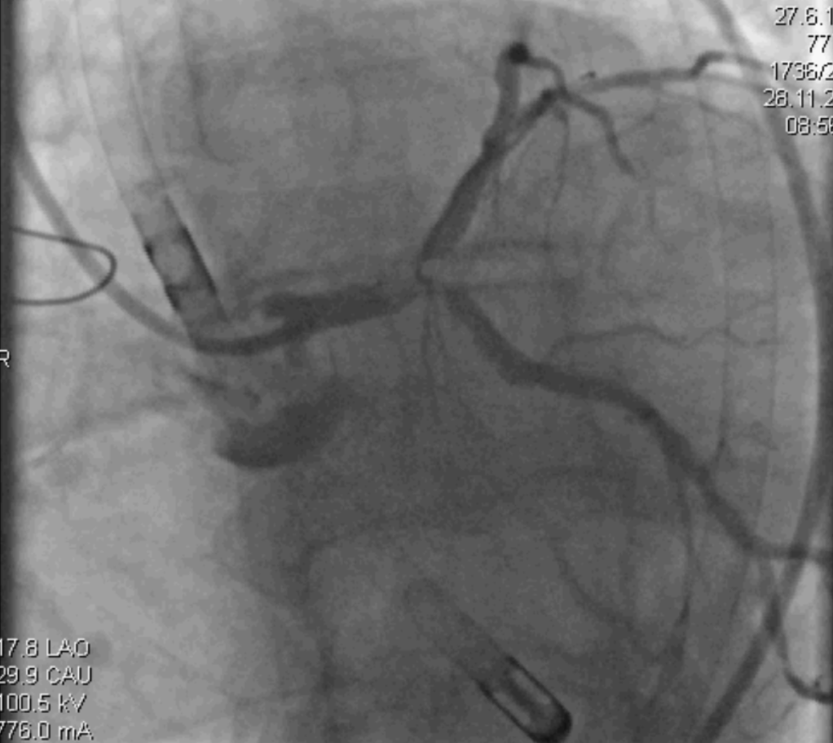
Vysoké ischemické riziko

Slide 29
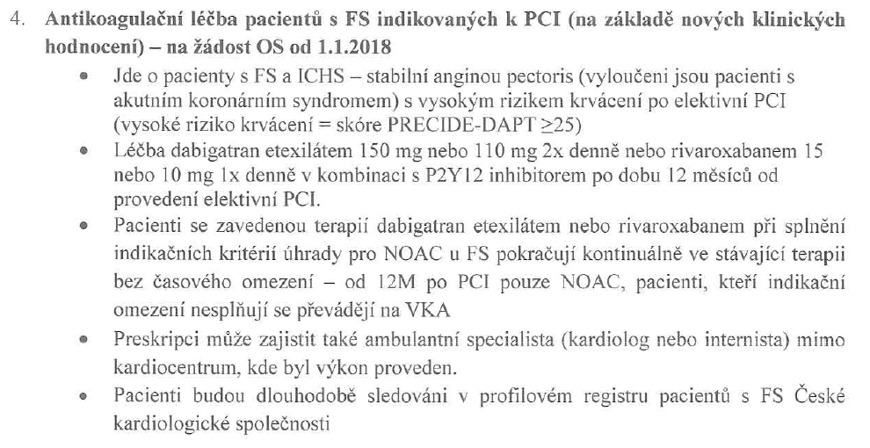
Společná dohoda VZP ČR, ČKS a SAS k preskripci antikoagulačních přípravků – aktualizace 6. 2. 2018
Svaz zdravotních pojišťoven respektuje úhradová omezení tak, jak je vydal SÚKL 1. 5. 2012, zveřejněné na www.sukl.cz

Slide 31
AUGUSTUS : trombóza stentu po PCI při fibrilaci síní
3498 PCI …………………….. 57 trombóz stentu (1,6%)
80% během prvních 30 dnů
Apixaban : warfarin HR = 0.76 (95% CI 0.37 – 1.56)
Aspirin : placebo HR = 0.58 (95% CI 0.28 – 1.22)

